Slide 1


Citizens’ Senate meeting no 34
^{16th} December 2021
Presenter: Trevor Fernandes
Moderator: Szara Coote

Slide 2
Agenda
11.00 - Welcome & intro. Reinforce the purpose of the Citizens’ Senate
11.05 - Update on activity with Eastern
11.15 - The role of pharmacy in primary care
11.45 - Q & A
12.00 - sharing experience
12.10 - EEAST PPI progress
12.30 – AOB & Close

Slide 3
Extend the Patient Voice
Involvement in programmes, services, policy & research
Access to specialist Health Professionals and speakers
Information and guidance on NHS policy and service change
Support innovation for patient benefit
Training and developmet opportunities

Slide 4
Agenda items
Citizens’ Senate and Eastern AHSN events / activity
18th Oct - Case study - best practice for engaging with the CS in coproduction
24th Nov - Eastern Company meeting - raising awareness
14 Dec - Lunch & share event - meeting new intake of Project Managers and Advisors
27th Jan 2022 - Insight to Impact masterclass

Slide 5
Agenda items
Getting more from your
Pharmacist
Paula Wilkinson
Chief Pharmacist
Mid Essex CCG
Notes:
5

Slide 6
Agenda items
Sharing experiences
Jeremy Dearling – voted Best Reviewer 2021 by the BMJ
Notes:
6

Slide 7

Agenda items
Notes:
7

Slide 8
Agenda items
Leading for Change Leadership training
Day 1 - 25th Jan 2022
Day 2 - 27th Jan 2022
Day 3 - 15th Feb 2022
Day 4 - 8th March 2022
To apply: Application form: https://surveys.eahsn.org/zs/ReB8bO
\
For more information contact Trevor Fernandes, citizens.senate@eahsn.org

Slide 9

CareCompare
Dr Adam Ali BMBCh, MA, MRCS
Director & Co-Founder
adam@carecompare.net
liban@carecompare.net
Carecompare.net

Slide 10
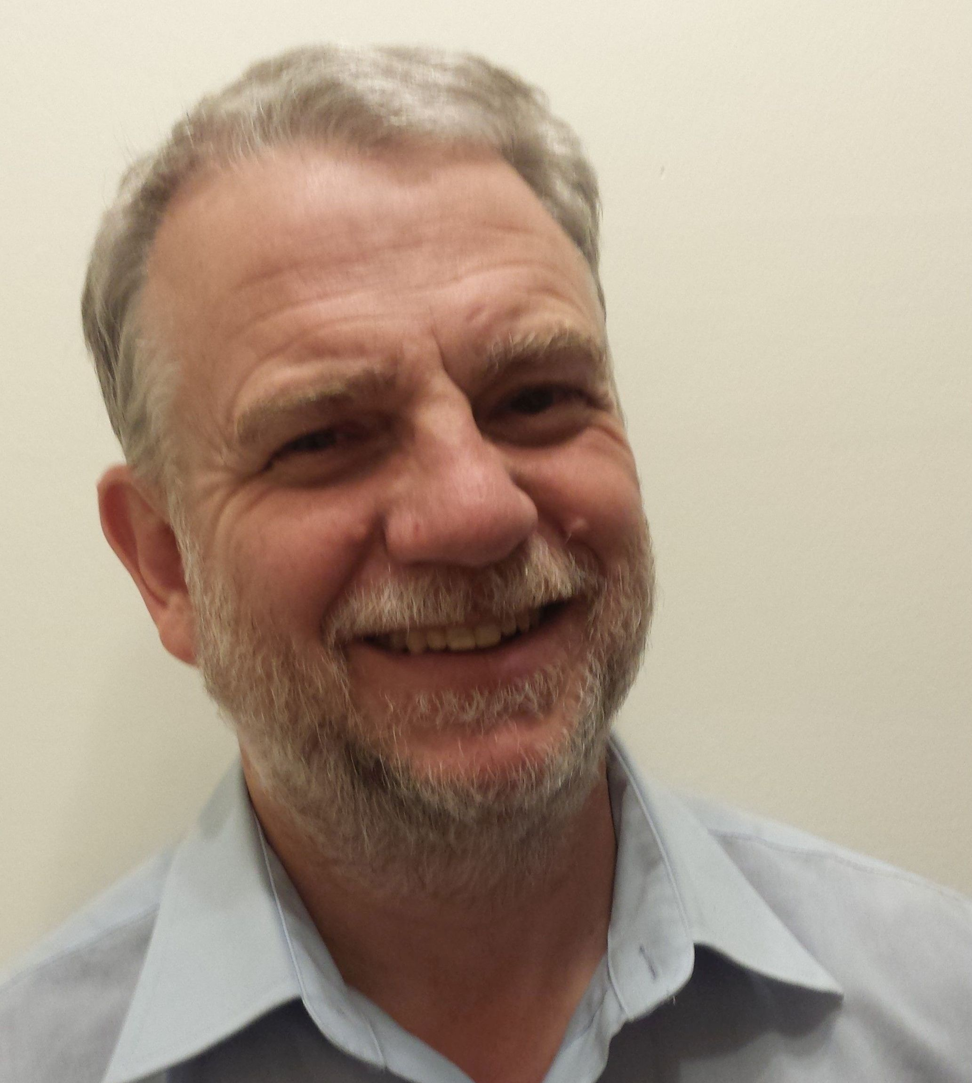
Action Learning Sets
Action Learning: a process that involves a small group working on real problems, taking action, and learning as individuals, as a team, and as an organisation.
Facilitated by Kevin Minier

