Slide 1
National Adoption and Spread Programmes:
Mental Health
Notes:
Dara Coppel, Head of Innovation Programme Delivery
Dara leads the implementation, sustainability and spread of national and local innovation programmes and manages the project Management team.

Slide 2
Eastern AHSN

Slide 3
Our purpose is to turn great ideas into positive health impact
We believe that health is improved by great ideas, but great ideas only make an impact when they are put into practice. Our health is too important to leave change to chance.
Notes:
Eastern AHSN turn ideas into health impact by bringing together all partners in the health sector to develop and deliver innovative care.

Slide 4
Our priorities
Mental Health
Cancer
Rare diseases and personalised medicine
The NHS Long Term Plan sets out a welcome emphasis on improving mental health services.
Cambridge is a world-leading centre for the development of new treatments for cancer.
The science of genomics has potential to pinpoint treatments for individual patients.
Living and ageing well
It is widely acknowledged that the solution rests in supporting the older population to age well.
Notes:
Listening to the care needs of our population and in line with a national focus, we have three distinct priorities: mental health, cancer, and rare diseases /personalised medicine
Our fourth priority underpins all of these – supporting living and ageing well, such as through the assistive technology we develop and self care programmes
In line with the NHS Long Term Plan emphasis on improving mental health services, particularly for younger people, we are supporting a number of innovations
We’re also supporting NHS cancer targets with our world-leading cancer centre in Cambridge and delivering pioneering research in rare disease and personalised medicine through our IBD data hub

Slide 5
The National ‘Adoption and Spread’ Programme’s
These are programmes that have been selected for national adoption and spread across the 15 AHSNs.
Developed regionally they have been selected due to strong evidence, positive evaluation and linked into NHSE priorities.
Will be rolled out across the AHSNs in 2020 – 2023

Slide 6
FOCUS ADHD PROGRAMME

Slide 7
FOCUS ADHD National Programme
Aim:
To enable NHS mental health trusts and community paediatric services across England to improve the ADHD assessment offered to children and young people.
Eastern AHSN will help to achieved this through:
Accelerating uptake and implementation of an objective ADHD assessment tool (currently QbTest) (measuring the three core components of attention, impulsivity and activity) to supplement current clinical assessment processes in the East of England.
Supporting changes in pathways, workforce and data collection, working with colleagues throughout the systems (NHSE&I; Trusts etc).
Develop a collaborative, supportive approach to implementation.
Notes:
Out of scope: This programme will not address improvements to the assessment process for adults nor will it directly address.
Now 45 Trusts using QbTest across 79 clinic sites in England – QbTest now used in more than 400 clinic sites globally.
Other benefits of the programme could include:
Mapping and identification of unmet needs in the system along the wider pathway (such as such as criteria thresholds to accept referrals or ongoing management of those diagnosed)
Consideration of ADHD workforce challenges
Identification of research gaps (such as longer-term impacts and social benefits);
Objectives:
Increase the number of children and young people who have an objective assessment as part of their assessment;
Reduction in time for assessment and decision making (from first referral to decision to diagnose/rule out);
Reduction in outpatient appointments – releasing clinical workforce time / reducing costs;
Reduction in nurse observation visits in schools;
Improved experience for children and families;
Improved clinical satisfaction and confidence in diagnosing or excluding ADHD; and,
Building the evidence base for an objective assessment to be routine within an ADHD assessment process.

Slide 8
Case for change in the East of England
ADHD assessments – varied pathways, assessment are mainly subjective with multiple steps, many sources of information, lengthy, often inefficient, confusing for patients and parents
Significant unmet need within the system.
Limited workforce causing workforce pressures.
High costs.
National Drivers
National policies (Future in Mind, 5 Year Forward View, NICE, Long Term Plan) – aim is to improve access to and the journey in MH services for patients.
Evidence (research and real world) to suggest the addition of an objective assessment tool (e.g. QbTest) can improve assessment journey.
Notes:
Set up demo on the back of key needs / drivers
Talked about in your last meeting and hat has been ID across the EOfE –
Children can fall through he gaps when bounced around the system
Plenty of policy to support this.
Future in Mind – looks at how CAMHS are delivered (improving access, developing the workforce)
5YFV MH – quick access to CAMHS, address waiting times
Transforming CYP MH – again about reducing the time to get treatment
NICE Guidance 2018: ADHD diagnosis and management – improving diagnosing and managing
LTP (2019) main focus on autism and Learning disability (with one line on ADHD diagnosis) - ADHD is not a priority within the Long Term Plan yet we know there is a significant unmet need for young people with ADHD (many specialist services currently treat about 0.5% of the local population in comparison to 5% prevalence of young people with ADHD in the community);

Slide 9
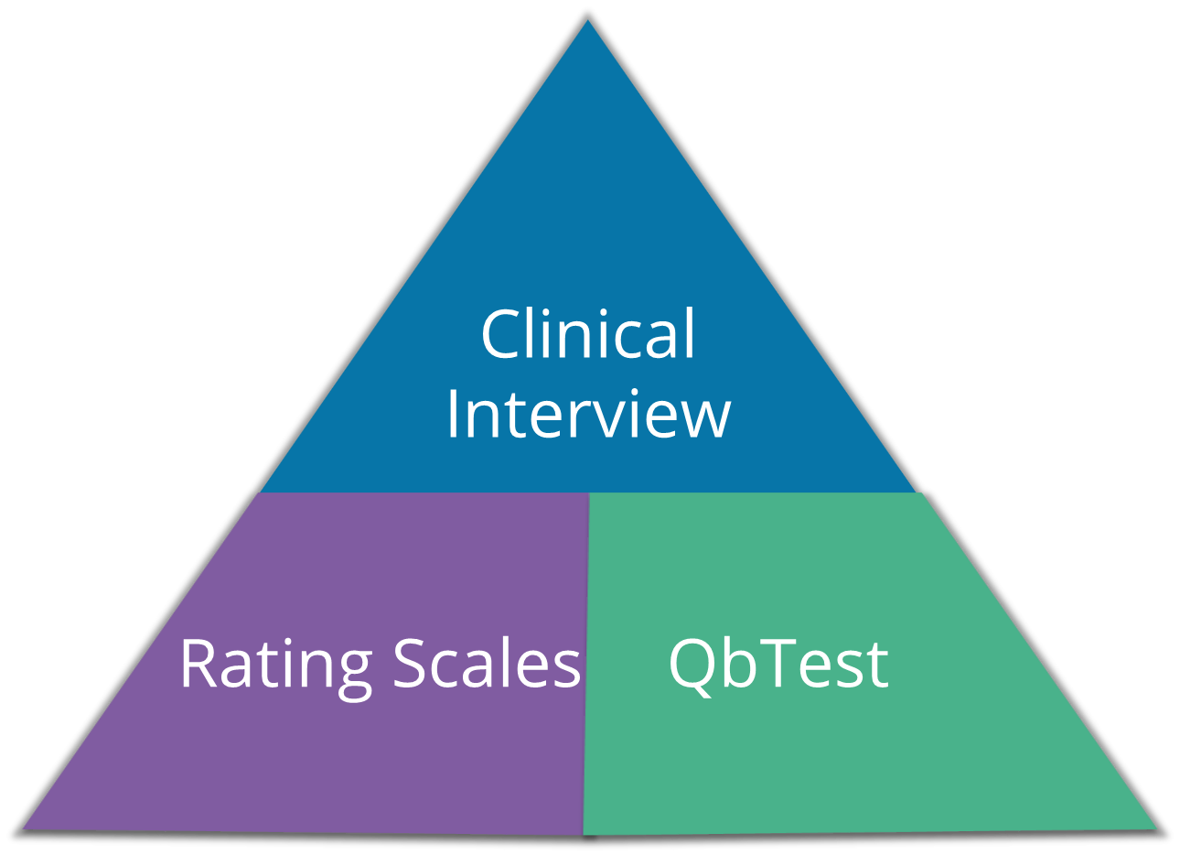
QbTest
What it can do
Provide quality/unbiased information, a clearer picture
Cut through ambiguous information
Standardises clinical practice
Highlights that individuals have different impairment and needs
Measure treatment effect for individuals
What it is not
A stand alone diagnostic tool
An instrument to replace clinical judgement

Slide 10
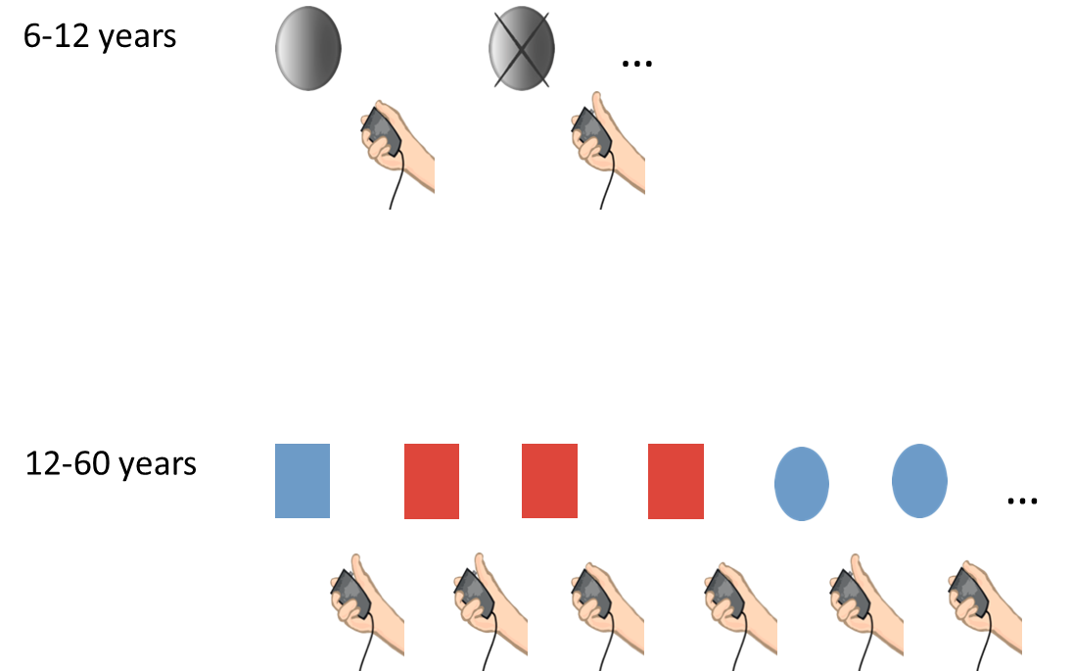
What does it involve?

Slide 11
EMAHSN ‘Real World’ Demonstrator QbTest
Aim: To include an objective assessment tool (QbTest) into assessment processes.
Three NHS trusts in the East Midlands (7 clinic sites),
12 month demonstrator – January to December 2017,
1231 children and young people assessed,
Varied baseline: different staffing models /ADHD pathways,
Structured approach to evaluation.
Improving patient experience;
Reducing time to reach a diagnostic decision; and,
Achieving greater efficiency within ADHD care.
Notes:
Set up demo on back of needs and drivers in the system:
LTP and multiple strategies issuing the need to improve access to MH services generally
Long waiting times for assessment of ADHD in child. High cost of assessments, high level of unmet need, limited workforce, mainly subjective information informing decision on whether CYP has ADHD or not.
Set up demo on back of RCT / audits / grey lit on the use of objective assessment tools.
CAMHS and/or com. paediatrics
We worked with three NHS Trusts over 12 months to demonstrate QbTest as part of their ADHD pathway.
Some provided ADHD assessment as part of CAMHS and others within acute paediatric medicine.
All three Trusts have sustained QbTest as part of their standard pathway and secured local funding through business cases to their Trusts.

Slide 12
East Midlands Demonstrator Results
Time from assessment to diagnosis reduced by 153 days or approximately 5 months (median).
Number of appointments to make a diagnostic decision reduced by 1 (for two trusts).
Released 20% clinical workforce time (varied between 20% and 33%)
94% of clinicians reported greater understanding of patients symptoms
85% of patients found the QbTest results helpful
ROI = £84,460 (range 14K to 94K)
£3.37 saving on every £1 spent from EM data (KSS)
Notes:
Assessments undertaken by band 4 HCA, freeing up consultant time
Reduction in the need for nurse school visits, as the QbTest provided the information.
Consultants had a more rounded picture of the patient
Consultants felt for supported in the decision making; and parents had a objective tests to
Time from assessment to diagnosis means that CYP can be put onto correct treatment or pathway quicker
Number of appointments – releases capacity for complex cases or reach unmet need
Figures on slide are the median across the three sites apart from survey feedback
Time from assessment to diagnosis:
Derbyshire: reduced by 166 days (approx. 5.5 months)
Leicestershire: reduced by 153 days (approx. 5 months)
Lincolnshire: reduced by 117 days (approx. 4 months)
Cost reductions
One model saw net cost reductions of 32.6% and 39.2%; where the other model was 9.85% (mean estimates)
Released clinical workforce time
20%, 20% and 33%
ROI - £14,300 £84,460 £93,900
Efficiency gains greatest in clinics where QbTest used early in the assessment process
** All sites sustained the implementation of QbTests beyond EMAHSN funding **
BIM

Slide 13
EARLY INTERVENTION EATING DISORDERS PROGRAMME

Slide 14
What is an Eating Disorder’s and why is it an priority area?
Eating disorders is an umbrella term for a mental health disorder characterised by an unhealthy attitude towards food which takes over an individual’s life and leads to a combination of various mental and physical health issues.
The most common eating disorders are: anorexia nervosa (AN); bulimia nervosa (BN); binge eating disorder (BED; and other specified feeding or eating disorder (OSFED).
Anorexia nervosa, has one of the highest mortality rates of any psychiatric disorders - 5.6% per decade (Sullivan., 1995).
Peak onset for an eating disorders is during adolescence and early adulthood, a sensitive time when the brain is still developing. Evidence from research studies suggests that treatment outcomes are best if the condition is identified and treated at the earliest opportunity.
Notes:
NHS LTP
NHSE

Slide 15
Background to the AHSN Programme
The National programme will focus on achieving improved outcomes across England, including scaling up existing models that we know work.
One approach is the FREED (First episode Rapid Early intervention for Eating Disorders) model - an evidence-based, specialist care package for 16 to 25-year-olds with a first episode eating disorder of less than three years’ duration.
The model overcomes barriers to early treatment and recovery and provides highly coordinated early care, with a central focus on reducing the duration of an untreated eating disorder. It consists of a service model and a care package.

Slide 16
Programme Vision and Outcomes
“Eastern AHSN will be supporting mental health teams across the region to speed up diagnosis and treatment of eating disorders in young people aged 16 to 25.”
Earlier intervention and treatment of eating disorders in young people;
Reduction in the length of time young people have untreated eating disorders;
Reduction in waiting times, day/in-patient admissions and bed days;
Cost savings through reduced use of healthcare services; and
Reduced need for day/in-patient admissions.

Slide 17
SERVICE USER AND CARER INVOLVEMENT AND PARTICIPATION

Slide 20
Thank you for listening
Nick Clarke
Nick.Clarke@eahsn.org

