Slide 1


Citizens’ Senate meeting no 33
28th October 2021
Presenter: Trevor Fernandes
Moderator: Szara Coote

Slide 2
Agenda
11.00 - Welcome & intro
Reinforce the purpose of the Citizens’ Senate
11.05 - Leading for Change training commencing in Jan
11.15 - CareCompare - innovator & founder, Adam Ali and Liban will be presenting their digital comparison tool and how patients cam benefit
11.35 - Q & A
11.45 - Action Learning Sets - Kevin Minier, Citizens’ Senate member
12.30 - Close
Next CS meeting – 16/12/2021

Slide 3
Extend the Patient Voice
Involvement in programmes, services, policy & research
Access to specialist Health Professionals and speakers
Information and guidance on NHS policy and service change
Support innovation for patient benefit
Training and developmet opportunities

Slide 4
Agenda items
Leading for Change Leadership training
Day 1 - 25th Jan 2022
Day 2 - 27th Jan 2022
Day 3 - 15th Feb 2022
Day 4 - 8th March 2022
To apply: Application form: https://surveys.eahsn.org/zs/ReB8bO
\
For more information contact Trevor Fernandes, citizens.senate@eahsn.org

Slide 5

CareCompare
Dr Adam Ali BMBCh, MA, MRCS
Director & Co-Founder
adam@carecompare.net
liban@carecompare.net
Carecompare.net

Slide 6
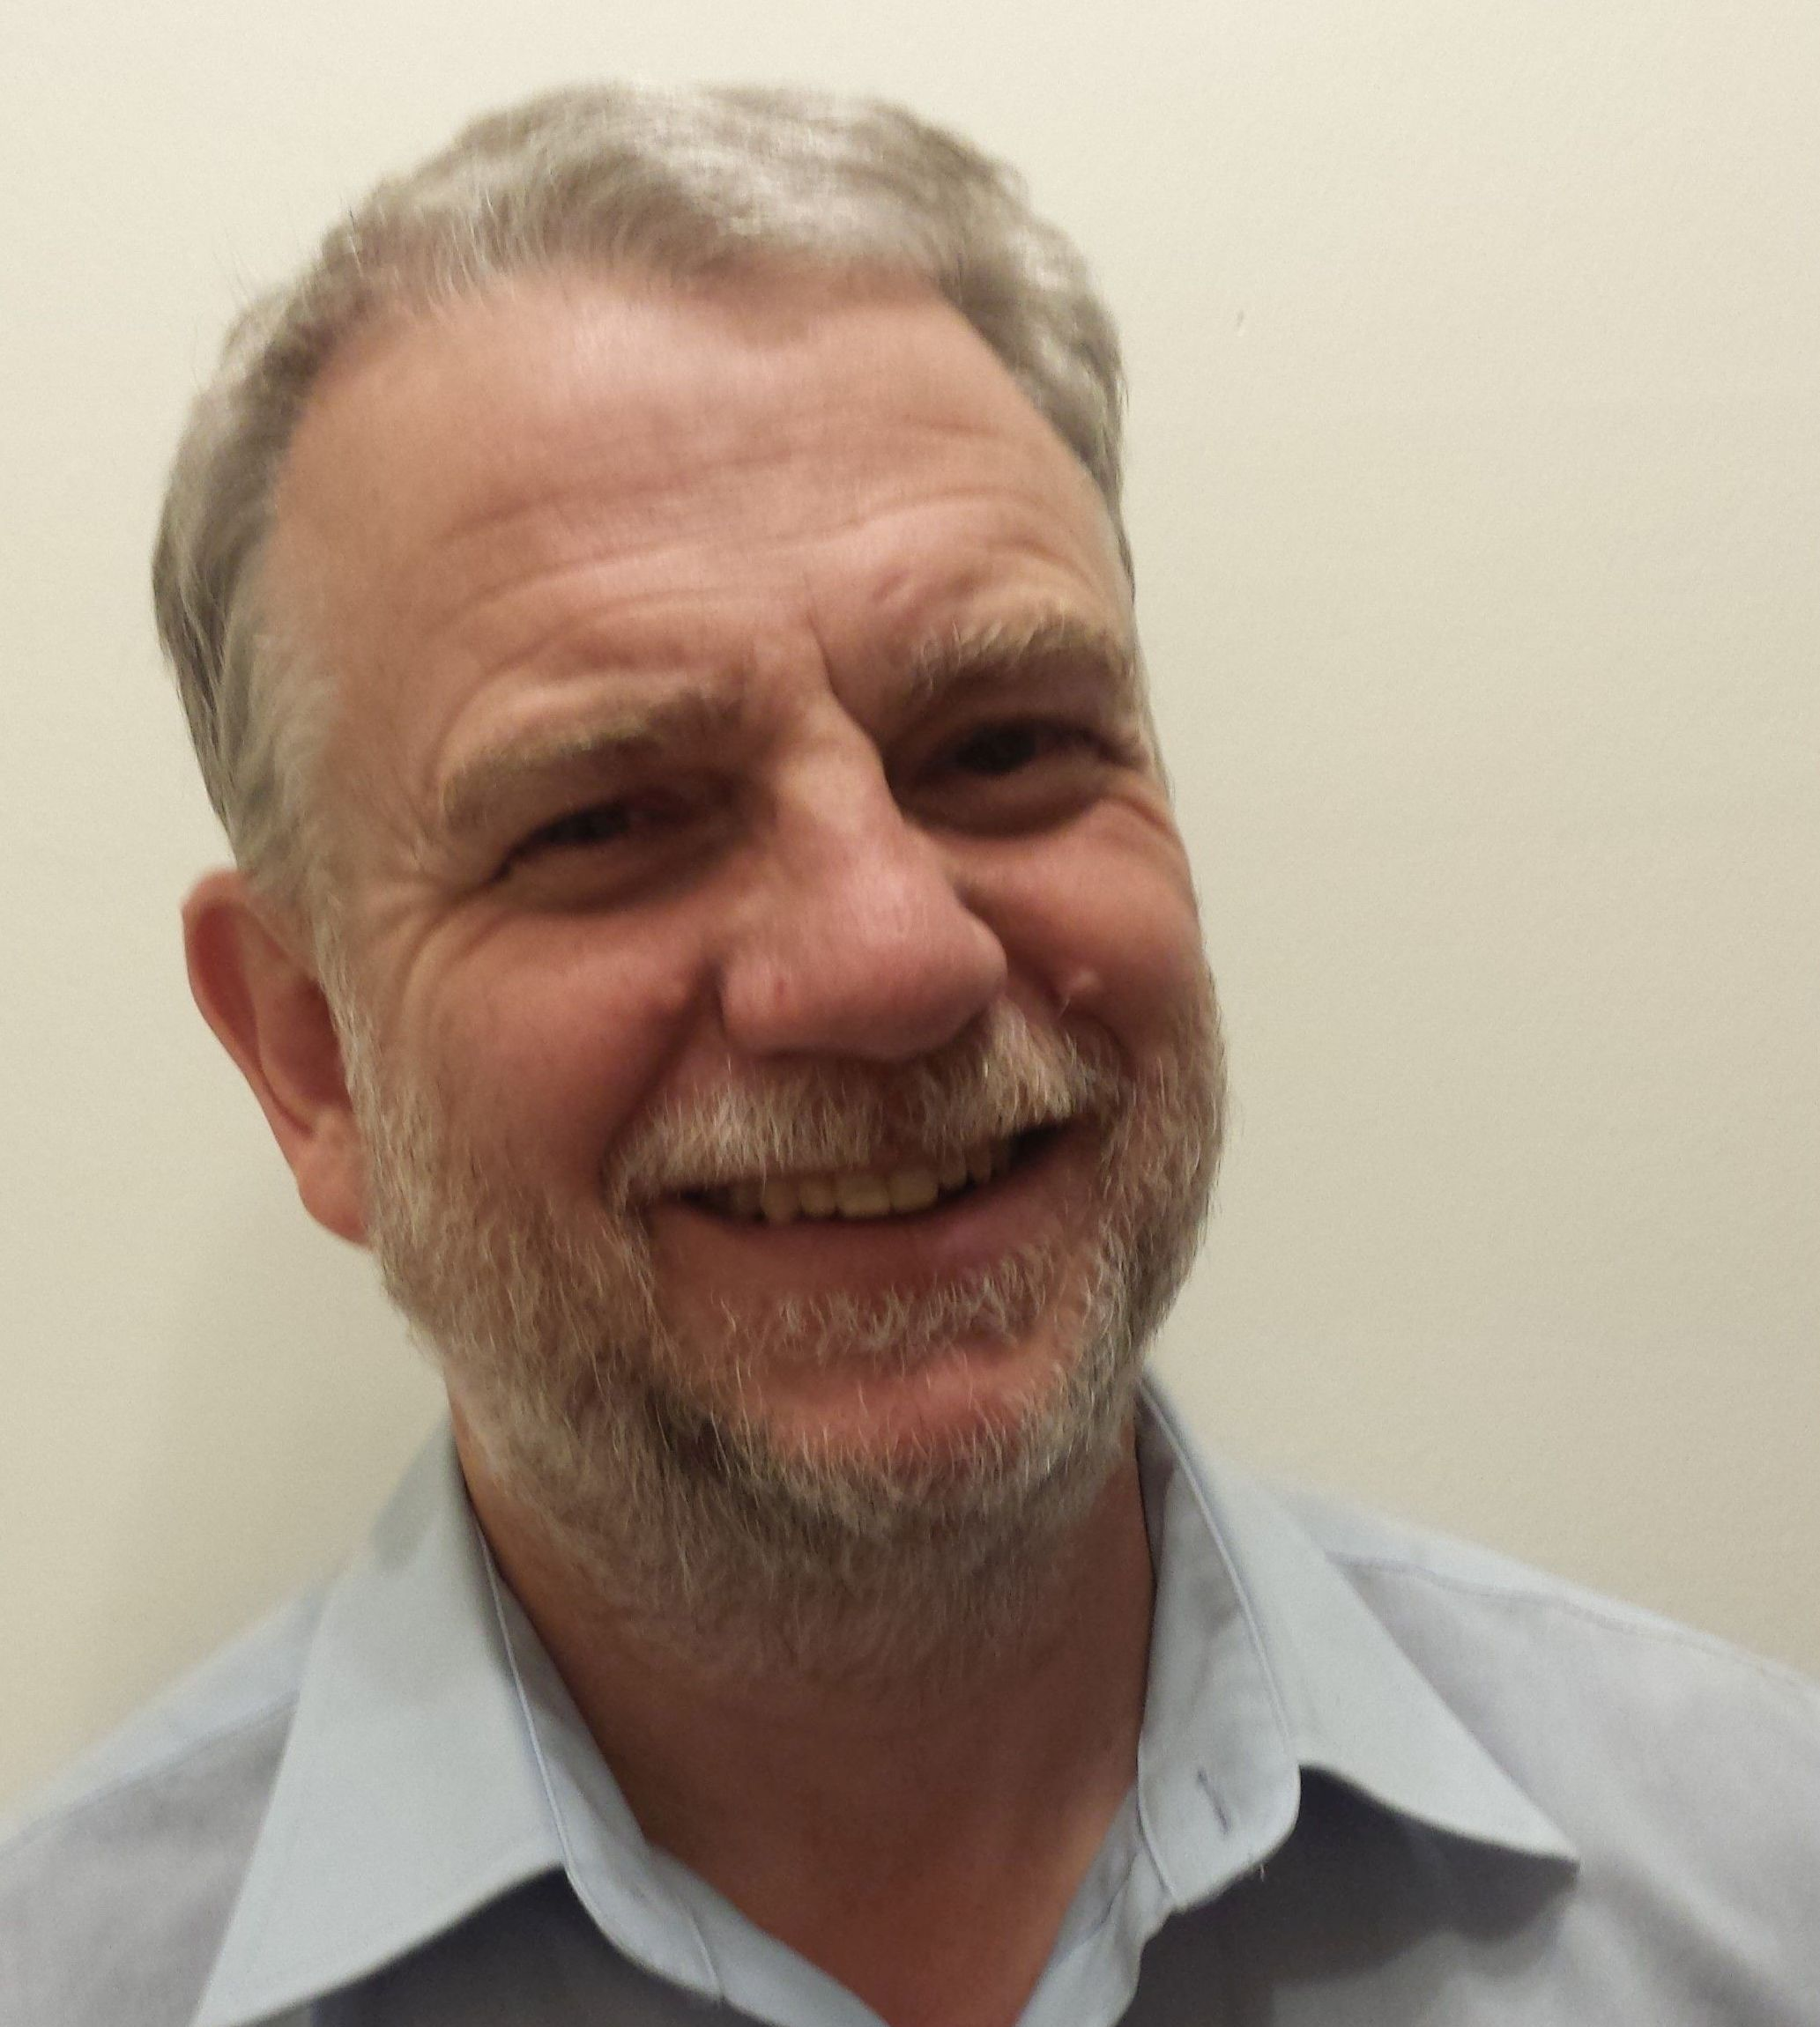
Action Learning Sets
Action Learning: a process that involves a small group working on real problems, taking action, and learning as individuals, as a team, and as an organisation.
Facilitated by Kevin Minier

